Slide 1
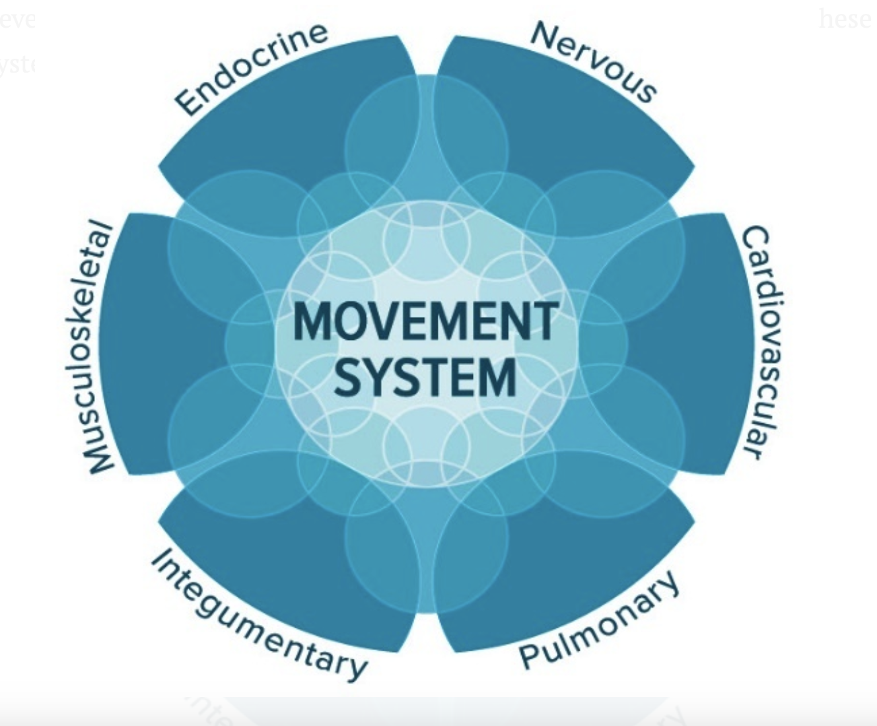
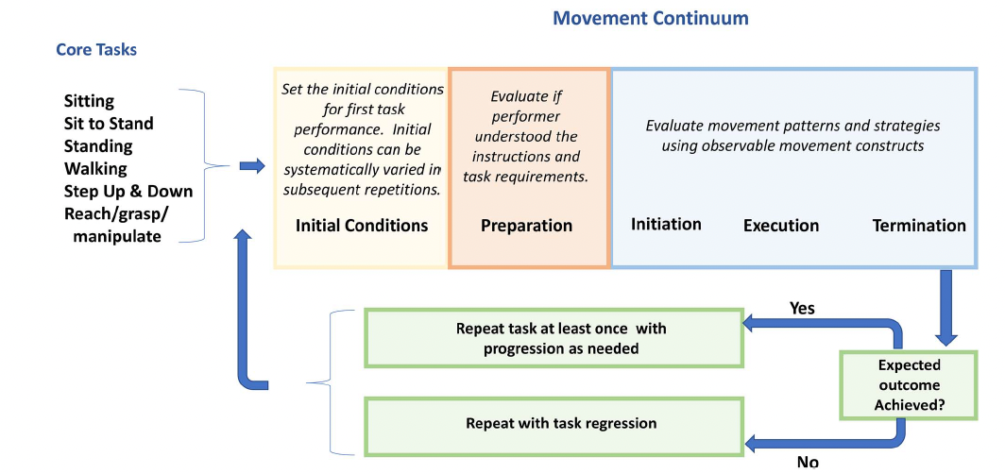
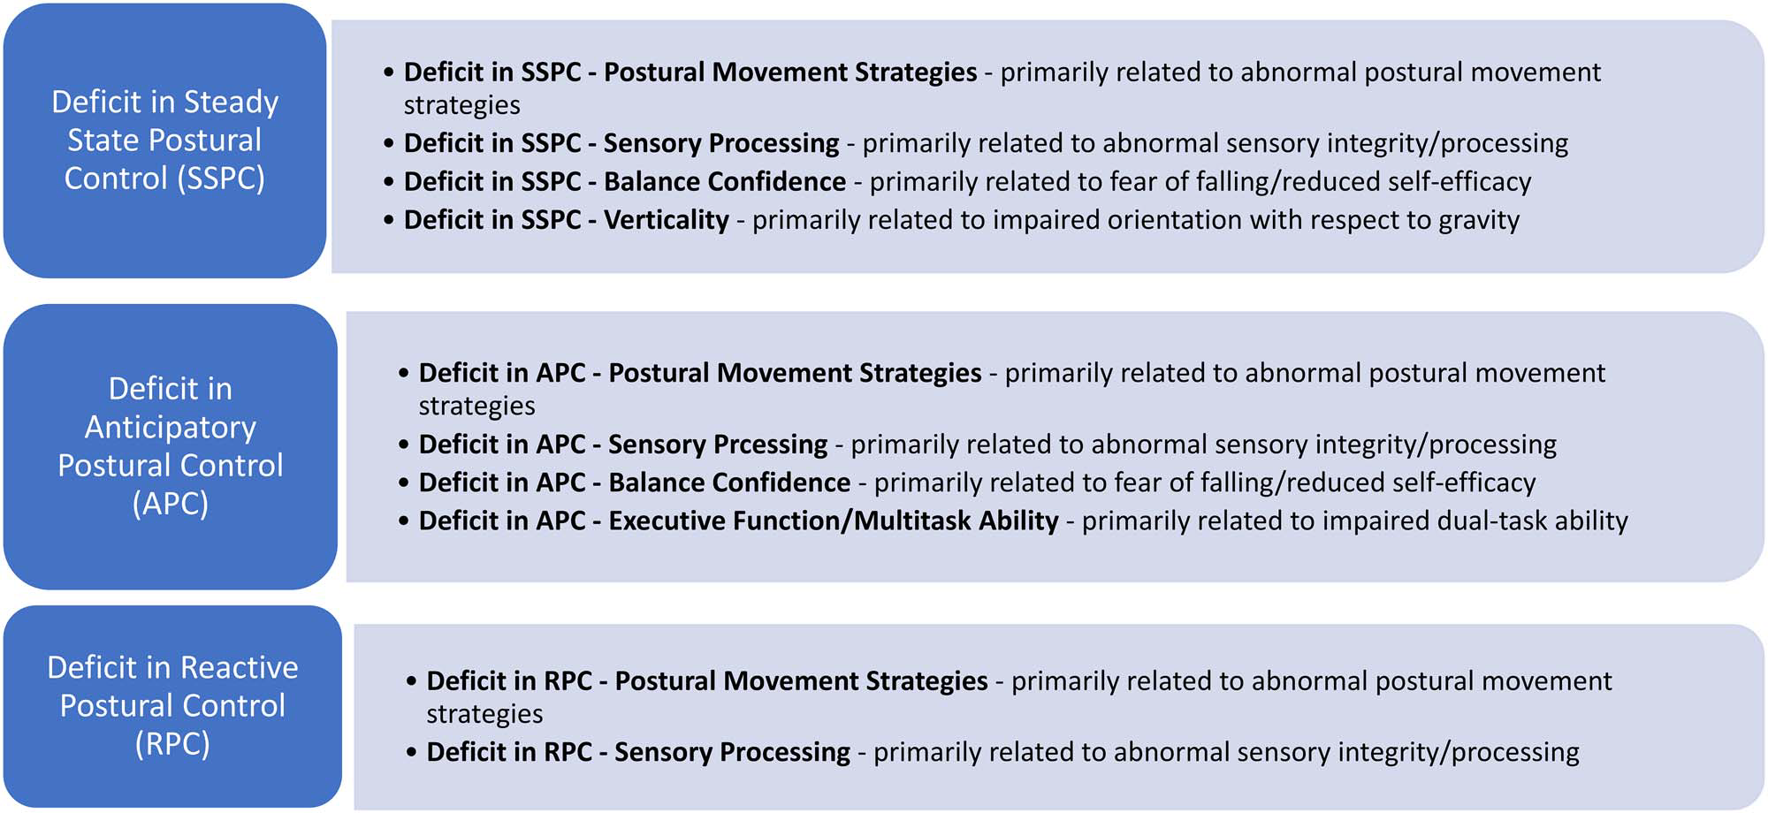
Academy of Neurologic Physical Therapy Movement System Committee
Timeline and Background
2013
APTA HOD Vision: “transforming society by optimizing movement to improve the human experience” (ref)
2015
The ANPT Movement System Diagnosis (MSD) Task Force is formed.
2018
ANPT MSD Task Force publishes White Paper (link)
2021
Framework for
Movement Analysis
of Tasks (link) developed and published
2021
Movement System Diagnoses for Balance Dysfunction (link) developed and published
2023
Knowledge Translation Task Forces formed
Framework for Movement Analysis of Tasks:
Formed 2 subgroups to develop:
standardized movement analysis of tasks
(2) diagnoses for balance dysfunction
- analyze movement patterns during task performance using defined observable movement constructs to characterize observations
- systematically apply task or environmental variations to help therapist generate hypotheses that can be tested with further examination.
develop expertise in movement system and diagnosis of movement system problems and
develop examples of content that may be used to describe human movement system problems.
(1) Movement Analysis of Tasks (link)
(2) Movement System Diagnoses for Balance Dysfunction (link)
Adopted the Movement System: “The integration of body systems that generate and maintain movement at all levels of bodily function.”(ref)
Movement System Diagnoses Balance Dysfunction
- labeled by combination of balance control strategies with relevant underlying determinants.
- described by key movement observations and key results from tests and measures.

